Slide 1
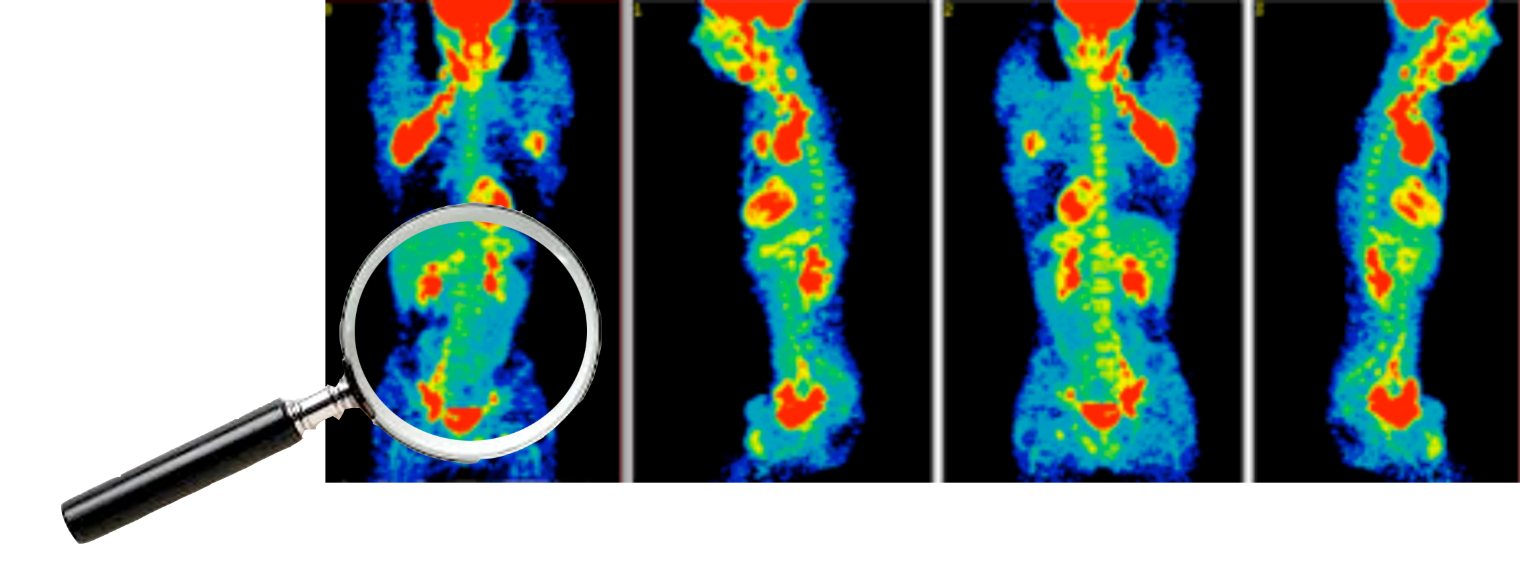
Cancer UNIT 5
How do we diagnose and treat cancer?

Slide 2
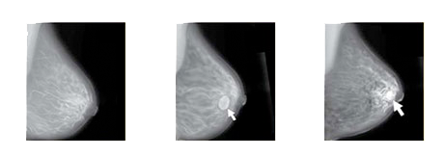
Cancer
Lesson 5.1
How do we detect cancer?

Slide 3
Do Now
Why is it important to detect tumors early?
What kind of tests are available to detect tumors?

Slide 4
Early detection is the KEY!
Screens – Done to test HEALTHY people.
Diagnostic tests – Done on people reporting SYMPTOMS.

Slide 5
Detecting tumors
Screens | Diagnostics
Looking for changes | Imaging
Noticing symptoms | Biopsy
Imaging
Genetics
Chemical markers

Slide 6
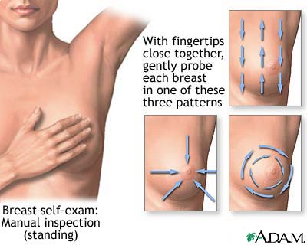
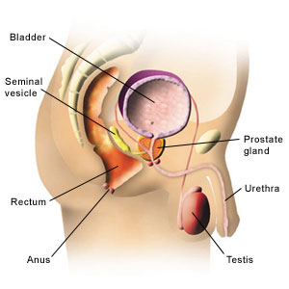
Screens: Routine self exams

Slide 7
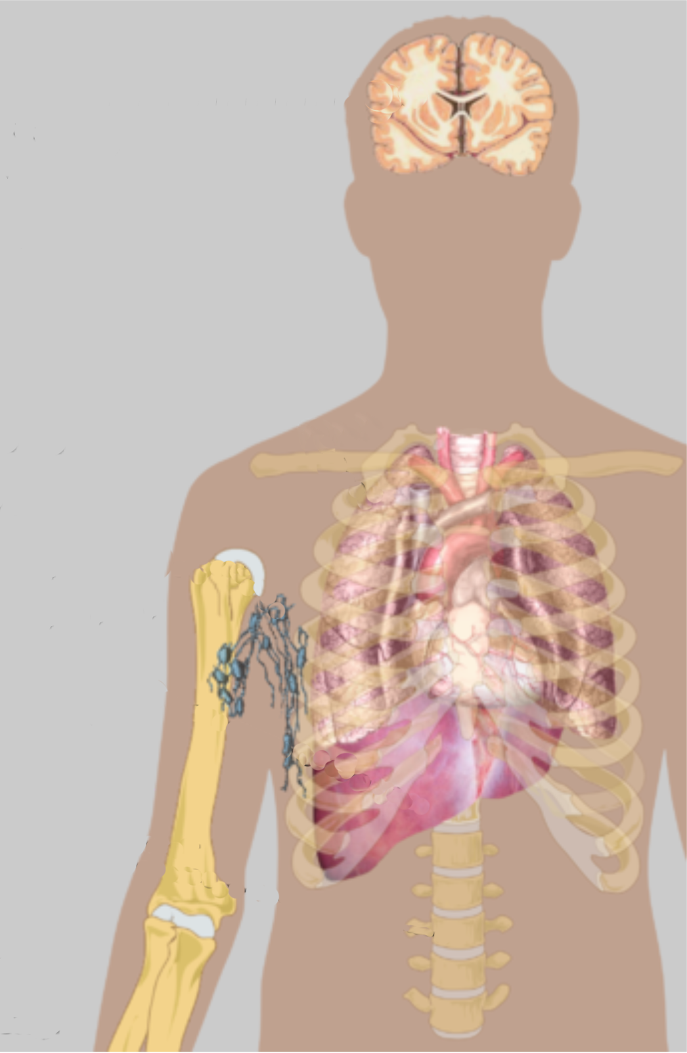
Screens: Noticing symptoms
Headaches
Nausea
Vertigo
Cough
Shortness of breath
Blood in sputum
Swollen lymph
nodes
Jaundice
Enlarged liver
Pain
Compression fracture

Slide 8
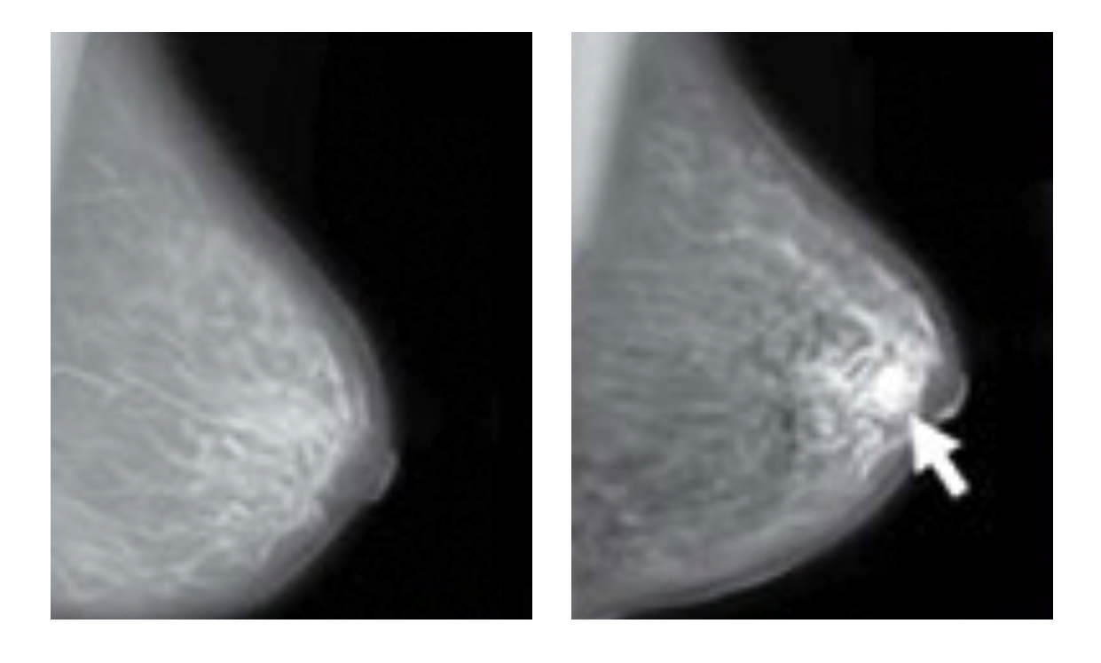
Screens: Imaging
Normal breast
tissue
Dense tissue
Notes:
Image sources
Breast: http://www.lindsayblogs.com/wp-content/uploads/2011/10/Ultrasound.jpg
X-ray: http://commons.wikimedia.org/wiki/File:X-ray_chest_cancer.jpg
MRI: https://www.ksu.edu/parasitology/cancer.html

Slide 9
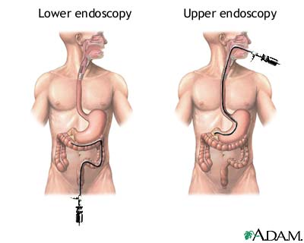
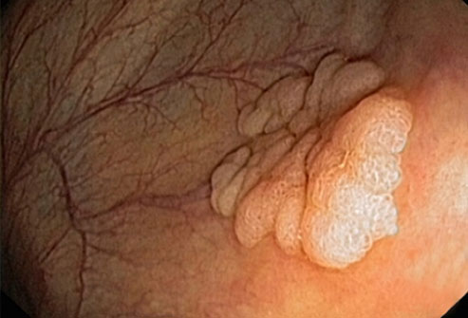
Screens: Imaging
Tumor biopsy
Tumor on
small intestine wall
Preventative screen - endoscopy
Notes:
Image sources
Biopsy: http://www.hopkinsmedicine.org/liver_tumor_center/conditions/cancerous_liver_tumors/hepatocellular_carcinoma.html
Blood Sample: http://www.pharmaceutical-technology.com/contractors/trials/cepha/cepha3.html

Slide 10
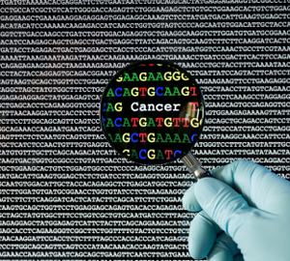
Screens: Genetic tests
Notes:
Image sources
Biopsy: http://www.hopkinsmedicine.org/liver_tumor_center/conditions/cancerous_liver_tumors/hepatocellular_carcinoma.html
Blood Sample: http://www.pharmaceutical-technology.com/contractors/trials/cepha/cepha3.html

Slide 11
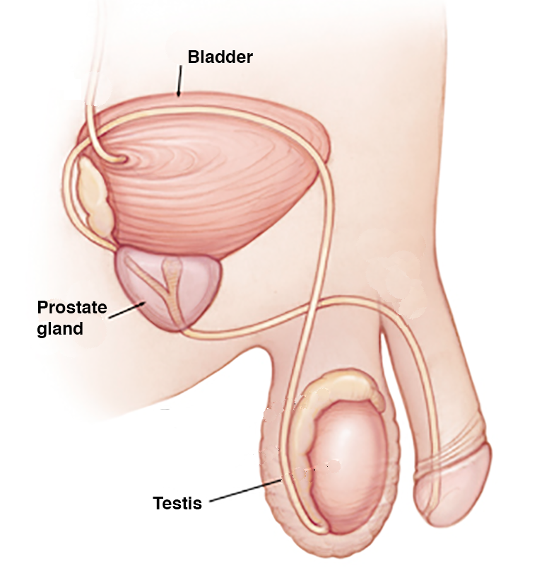
Screens: Chemical markers
Notes:
Image sources
Biopsy: http://www.hopkinsmedicine.org/liver_tumor_center/conditions/cancerous_liver_tumors/hepatocellular_carcinoma.html
Blood Sample: http://www.pharmaceutical-technology.com/contractors/trials/cepha/cepha3.html

Slide 12
Identifying tumors
Screens | Diagnostics
Looking for changes | Imaging
Noticing symptoms | Biopsy
Imaging
Genetics
Chemical markers

Slide 13
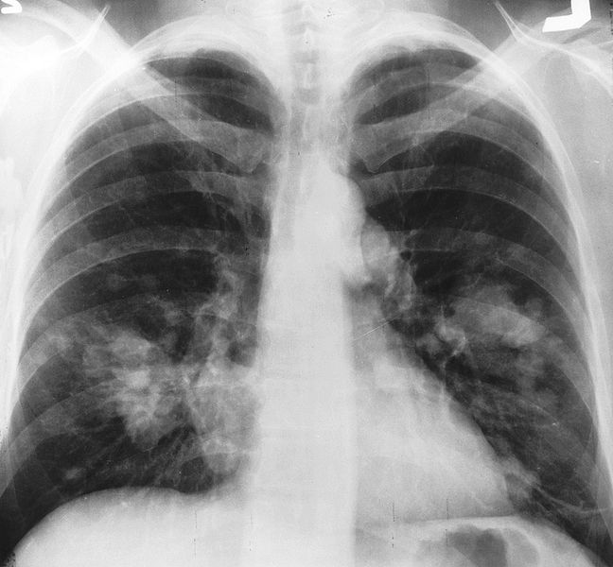
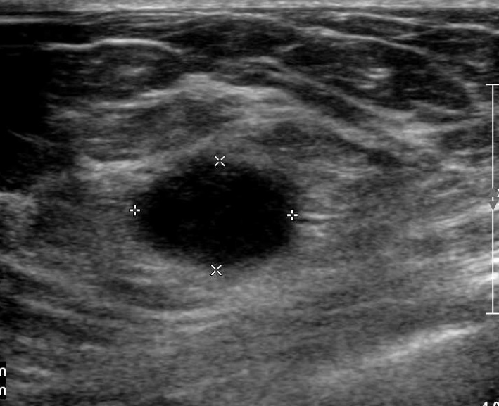
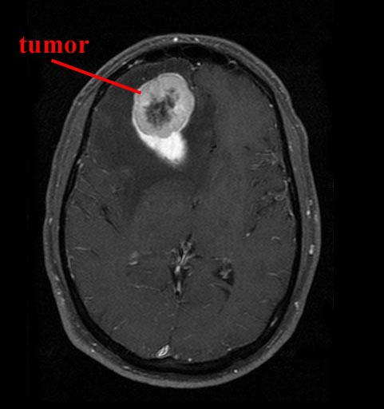
Diagnostics: Imaging
X-ray
Ultrasound
MRI
Notes:
Image sources
Breast: http://www.lindsayblogs.com/wp-content/uploads/2011/10/Ultrasound.jpg
X-ray: http://commons.wikimedia.org/wiki/File:X-ray_chest_cancer.jpg
MRI: https://www.ksu.edu/parasitology/cancer.html

Slide 14
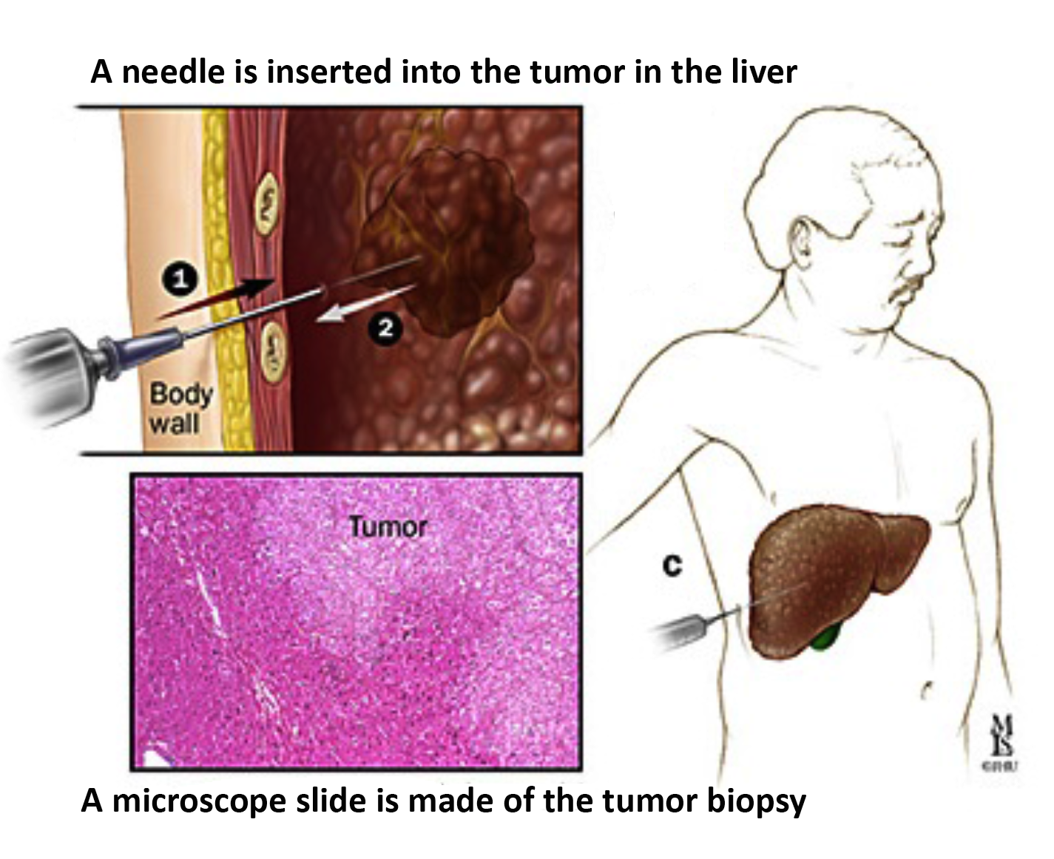
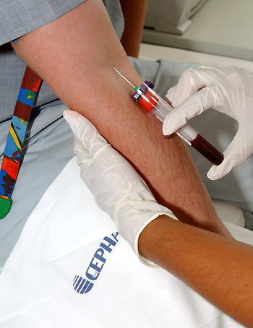
Diagnostics: Biopsy
MRI
Tumor biopsy
Blood sample
Notes:
Image sources
Biopsy: http://www.hopkinsmedicine.org/liver_tumor_center/conditions/cancerous_liver_tumors/hepatocellular_carcinoma.html
Blood Sample: http://www.pharmaceutical-technology.com/contractors/trials/cepha/cepha3.html

Slide 15
Activity
Divide into groups. Each group will get a case study of different kinds of cancer, and a table of detection techniques.
Decide which tests you will use to try and diagnose the disease and why.
Then co-ordinate with the other groups who have your disease and compare notes.
Notes:
Breast cancer
Pancreatic cancer
Melanoma
Leukemia
Prostate cancer
Brain cancer
The tests available
X-ray,
MRI
Ultrasound
PET scan
biopsy
blood tests for biomarkers.

Slide 16
Wrap up
Why did you choose to do the tests you chose?
Is it always necessary to do all of the tests that are available?
What did you think about having to take cost into consideration?

Slide 17
Homework
Read the Boston Globe article on mammograns:
http://www.bostonglobe.com/lifestyle/health-wellness/2014/01/20/health-journalist-with-breast-cancer-finds-herself-caught-between-statistics-and-personal-decisions/ExNLbyqiMTnk9tGZjv2LoM/story.html

